Slide 1
Using Canvas Quizzes to Provide Interactive Learning Adventure GUIDES
Faculty Professional Development Workshop
Thursday September 19, 2024 ZOOM
3:15 pm - 4:15 pm
Denise Case, PhD, PE - CSIS

Slide 2
Overview
This presentation shows how to use Canvas Quizzes to take students on interactive learning adventures.
Each quiz becomes a GUIDE (a Guided Understanding and Interactive Discovery Event) that allows us to provide content, engage students, and enable auto-graded assessments that can be taken as often as needed for understanding.
GUIDE: Guided Understanding and Interactive Discovery Event
Learning is fun. :)

Slide 3
Objective: Enhance Student Learning
As instructors, we are here to:
Facilitate student learning
Assist students in building an understanding of course material.
Help students master key concepts and retain critical knowledge.
Support students while they develop skills in our field.
All learning is active learning - the work must be done by the students.
Our role is to provide the structure, tools, and guidance to support them on that journey. ^ Work, ^ Benefit

Slide 4
Approach: Guided Interactive Learning Adventures
Canvas provides a built-in step-by-step process for leading students through content like stepping stones: Quizzes - one question at a time.
This feature enables us to guide students through interactive journeys that break down complex content into manageable parts. We can:
Select a clear objective.
Teach a bit, ask a question
Continue the teach-ask cycle to help students engage with and absorb the material.
Optional: Conclude with a question bank to evaluate understanding.
Lots of flexibility! Each question can incorporate video, readings, web links, and more - for very dynamic and engaging learning experiences.
Fits all levels of students! Some students get it on the first pass, other students may revisit the journey multiple times. Taken as often as needed (more like our adult continuing education courses).

Slide 5
Benefits for Students
Enhanced, Required, Rewarded Engagement
Interactive quizzes require active participation, keeping students engaged with the course material.
Low-Fear, On-Demand Learning
Ample time limits reduce pressure, allowing students to focus on learning rather than racing the clock.
Quizzes can be retaken without penalty, promoting mastery over performance.
Can be used as a pre-test, during learning, or as a post-test for review and reinforcement.
Easy Access to Content
Quizzes are accessible on various devices, including mobile phones, giving students flexibility to learn on the go.
Ideal for learning in short bursts—whether at soccer practice, waiting in line, or between activities.

Slide 6
Benefits for Faculty
Front-Loaded Effort
Initial setup requires effort to create the guides, but subsequent maintenance is minimal, saving time in the long run.
Scales Well
The process is scalable, accommodating larger student numbers without increasing your workload.
Easy to Modify
Clearly labeled guides, aligned with specific learning objectives, are easy to locate and update.
Content and questions can be effortlessly adjusted as the course material and teaching strategies evolve.

Slide 7
Quick Start: The Goal & The Plan
The Goal
Fewer point-less pages (they don't show on the syllabus or deadline pages and students tend to miss them).
The Plan
Take a lecture page and copy and paste to a quiz, then ask a question at the end to verify they've accessed the learning content.
Now the lecture content appears on the students task schedules.
We know which students are accessing the material.
We can verify they've seen the lecture content.
You might want to have a percentage-based gradebook - we'll add a point or two and we don't always know how many points in advance.

Slide 8
Quick Start: The Implementation
Create a new quiz.
Take content from a lecture page and copy it into a quiz.
At the end of the content, include a simple question to confirm students have engaged with the material.

Slide 9
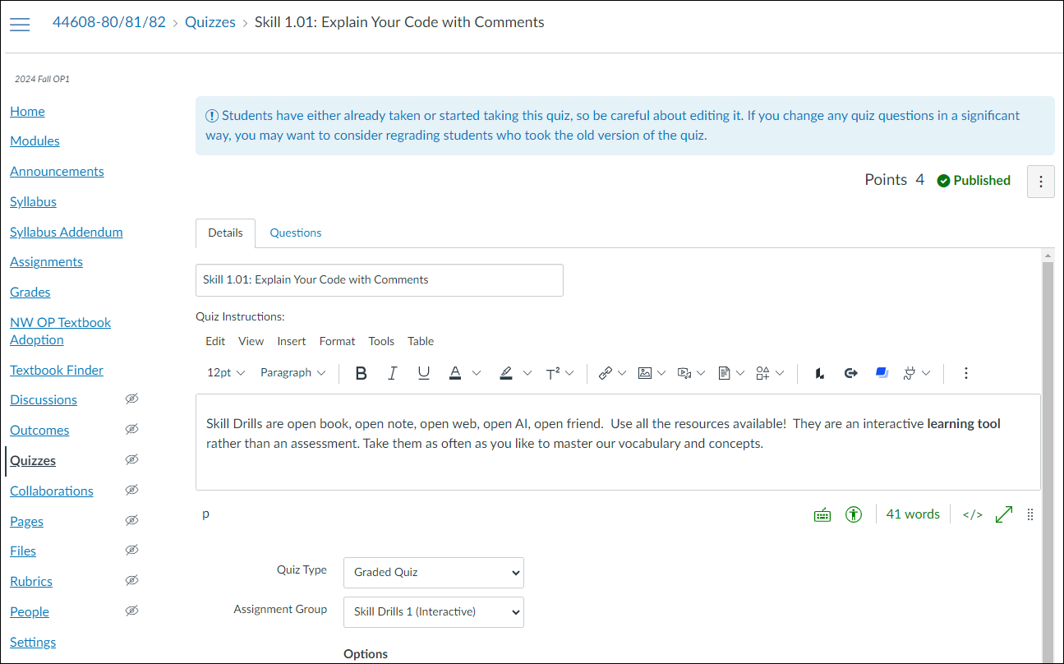
Quick Start: New Quiz (Guide, Skill Drill, etc.)

Slide 10
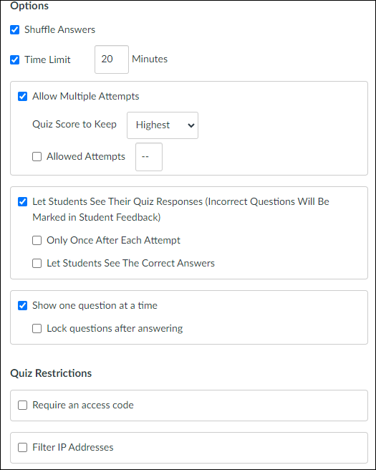
Quick Start
Quiz Options

Slide 11
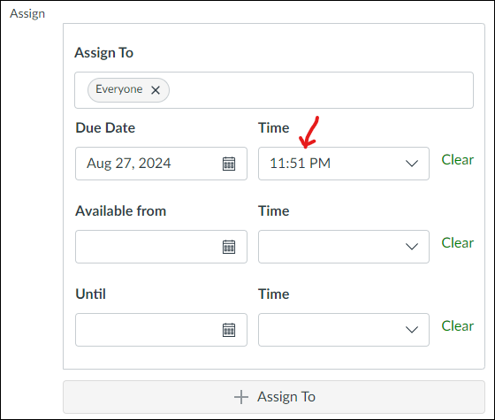
Quick Start Quiz Assign
I update the due date and time if multiple just so they appear on the calendar in the correct order.
There may be 3-5 interactive guides on a school day.

Slide 12
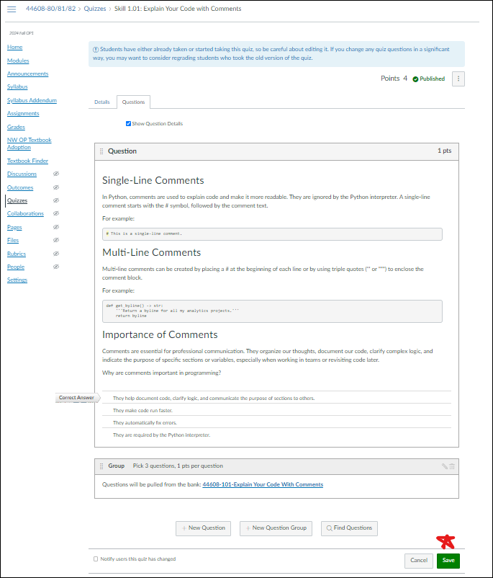
Quick Start:
Add a Question
Just copy and paste from the Canvas lecture page and add a question at the bottom.
1 point is fine.
Optional: This example includes drawing 3 more questions from a bank to ensure they understand the lesson content.

Slide 13
Implementation: Planning
Quizzes/Guides easily map to learning objectives - or break content into smaller skills.
In my fundamentals class, we moved from 3 submissions per week to 3 per day, with positive student feedback. (This was quite a surprise, actually.) :)
More assignments, smaller stakes fosters a sense of mastery and curiosity.
Serves as a Table of Contents - easy to find what they need
Guide 1.01: Explain Your Code with Comments

Slide 14
Implementation: Planning
Think of a course module - does it have a Canvas page of content, a video, or an article to read with no points or submission associated with it?
What skill do you want students to demonstrate after covering the learning content? Action words and tasks, key concept.
Works best with a percentage-based gradebook, allowing maximum flexibility to create as many 1-point questions as needed. (We can also vary question point values as desired.)
Might use a naming system like Module Number, Skill Number, and Skill Name for clarity and easy access.
Guide 1.01: Explain Your Code with Comments

Slide 15
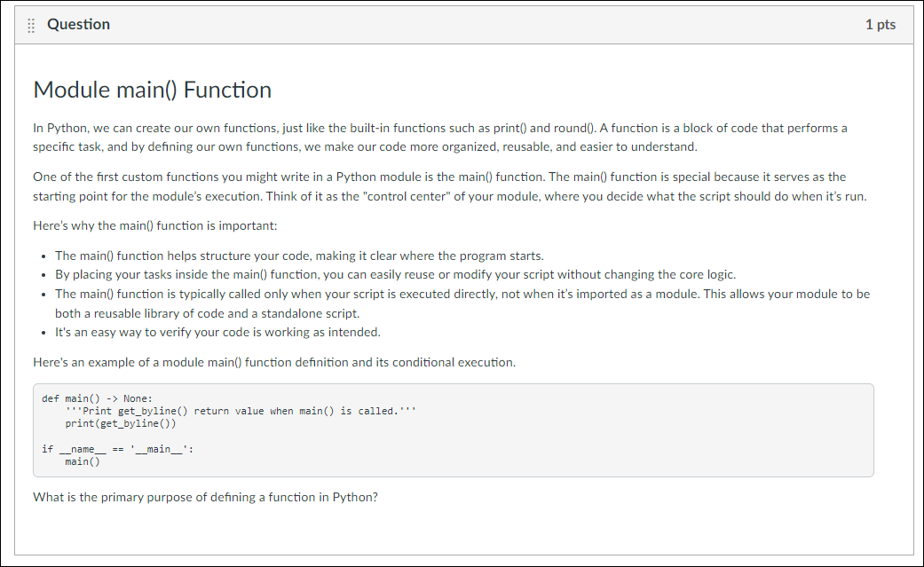
Implementation: Creating a GUIDE
Content -> Question

Slide 16
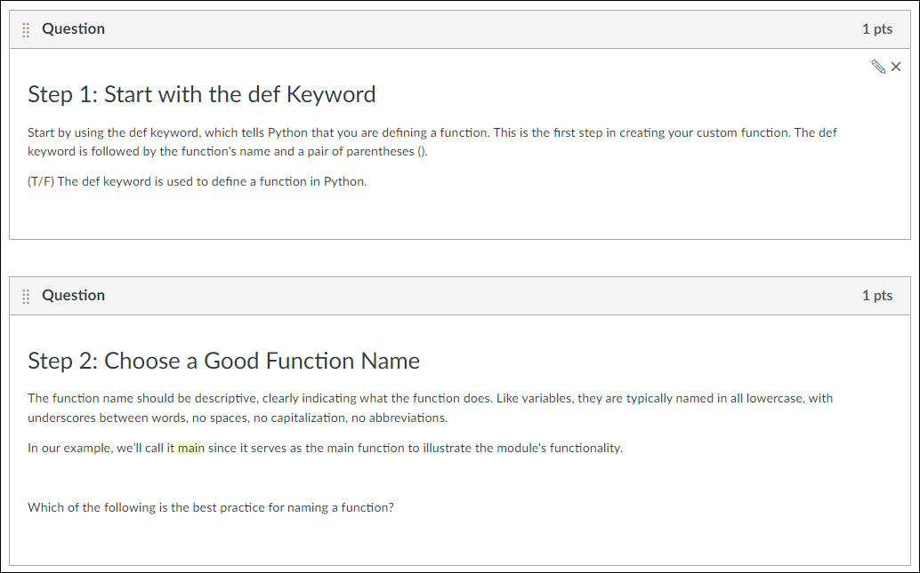
Implementation: Creating a GUIDE

Slide 17
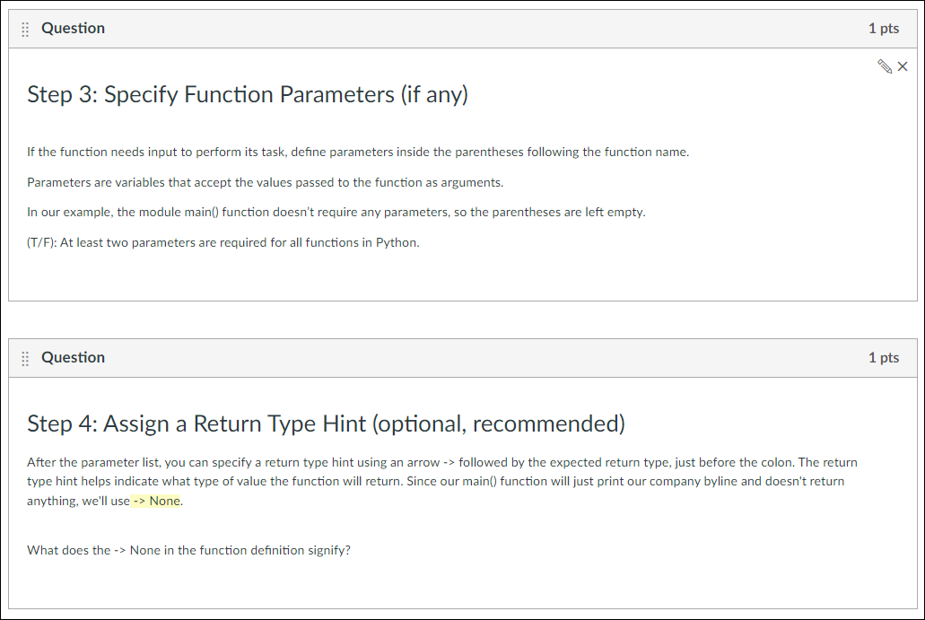
Implementation: Creating a GUIDE

Slide 18
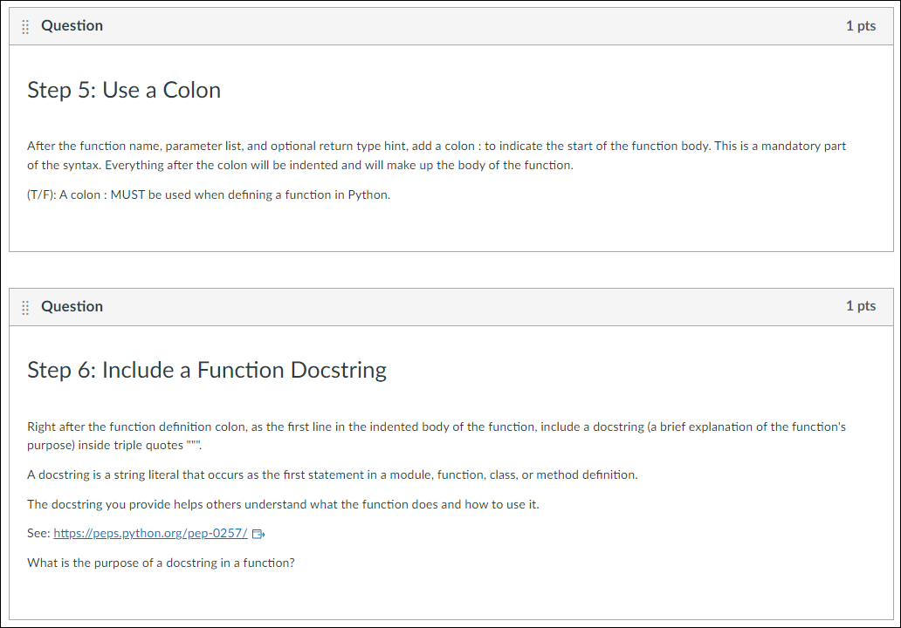
Implementation: Creating a GUIDE

Slide 19
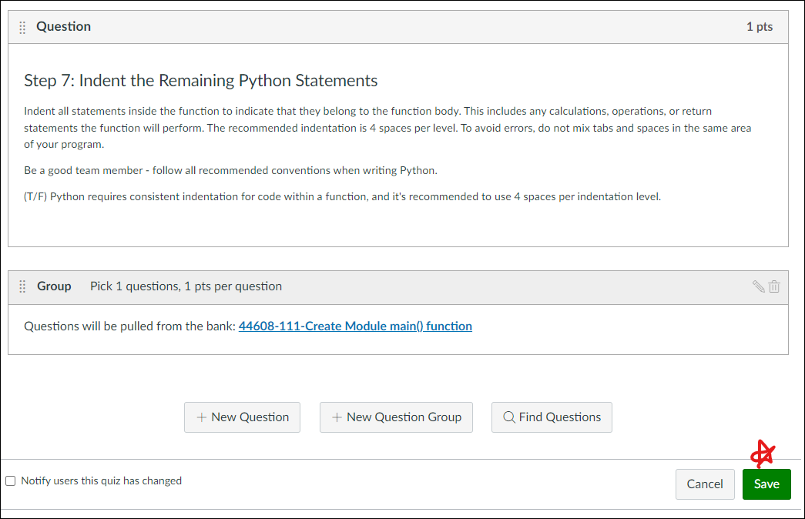
Implementation: Creating a GUIDE

Slide 20
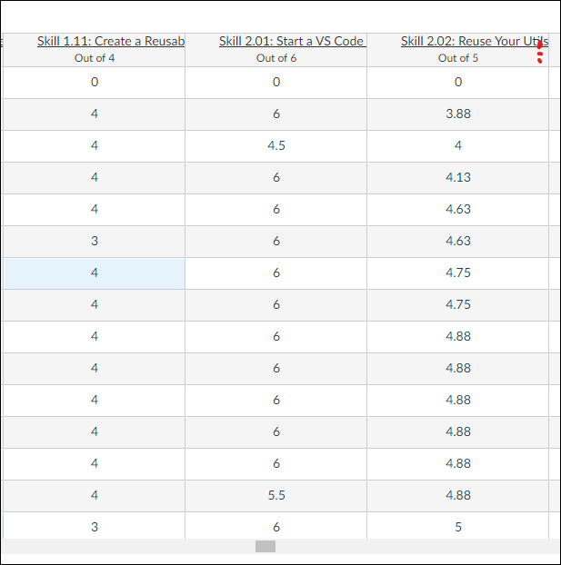
Implementation: Review and Regrading
When things go well, SpeedGrader is still the best.
IMPORTANT: Only available via the Gradebook.
If there's an error, I just fix it. Award credit to the person who called it to my attention and the later attempts will reflect the correct question options.

Slide 21
Tips: Students Can Listen to Pages
NaturalReader - AI Text to Speech Chrome Extension
Read aloud any text with realistic AI voices, compatible with webpages, kindle Ebooks, Google Docs, PDF, Emails, and more.
Canvas Supports Reading Pages (see your personal settings - not course settings)
This extension will read any web page.

Slide 22
Thanks and Q&A
Thank you for participating!
Many thanks to:
Alyssa Bugbee, NW Online & LTC Specialist
Dr. Gail Cullen, Assistant Director/Instructional Designer
Dr. Darla Runyon, Director, Northwest Online | Learning & Teaching Center
Any Questions?
Denise Case
dcase@nwmissouri.edu

